Slide 1

Futurense
Democratizing Tech Talent to deliver impact at scale

Slide 2
SQL MINI PROJECT
HEATHCARE MANAGEMENT
Jay Jathar
FT745

Slide 3
Overview:
Brief Description/Business Problem
A report needs to be generated using SQL statements for 55 problem statements related to healthcare management
Populate the well structured database
Analyse the problem statements
Write SQL queries
Insert the provided data into the tables using SQL insert statements or import data from excel file.
Carefully review each problem statement to identify the specific information required to address the problem.
Consider using appropriate joins, aggregations, and filtering conditions to obtain the desired results.
Solution Approach

Slide 4
Tools and Technologies Used:
MySQL
MySQL Workbench
DBeaver

Slide 5
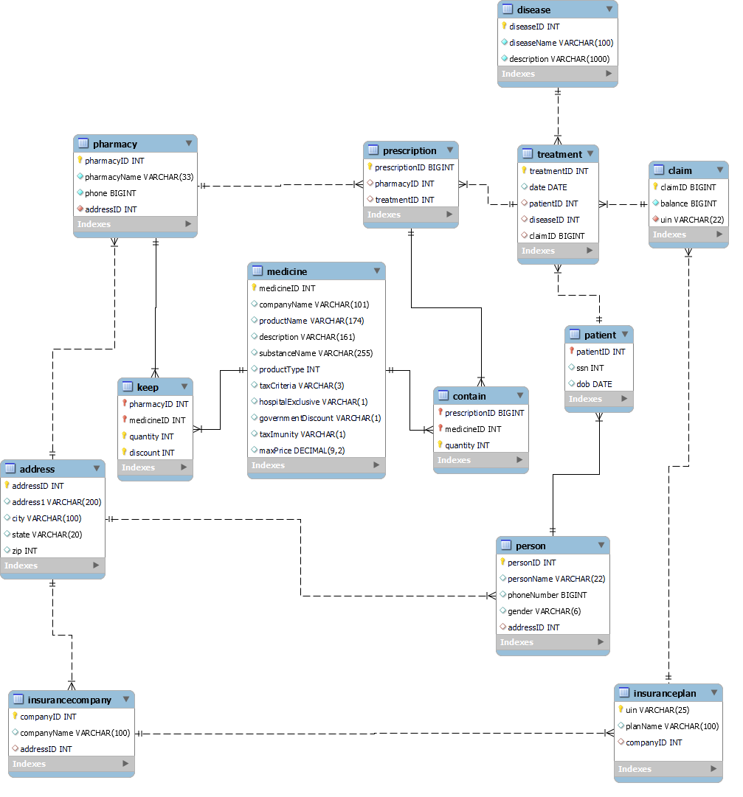
HEALTHCARE DATABASE SCHEMA

Slide 6
Operations on Schema:
Insurance plan table issue: Handled Duplicate by using Insert ignore into
Keep table: Handled Duplicate by making quantity and discount composite key
Contain table: Handled Duplicate by making quantity composite key
For all tables: created relation between tables using foreign constraint

Slide 7
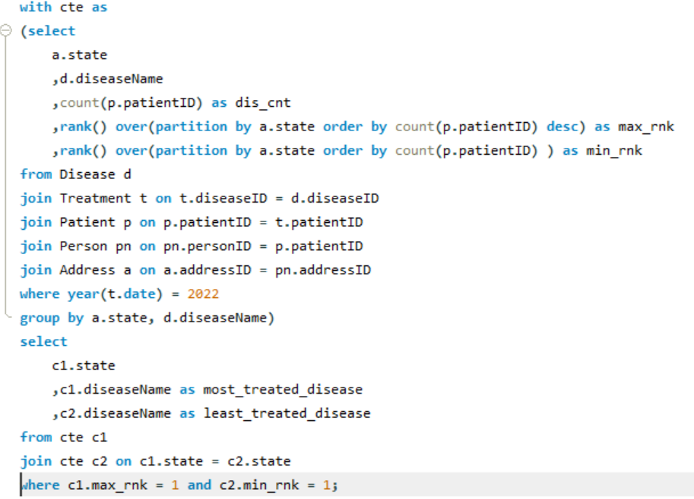
Sarah, from the healthcare department, is trying to understand if some diseases are spreading in a particular region. Assist Sarah by creating a report which shows for each state, the number of the most and least treated diseases by the patients of that state in the year 2022.

Slide 8
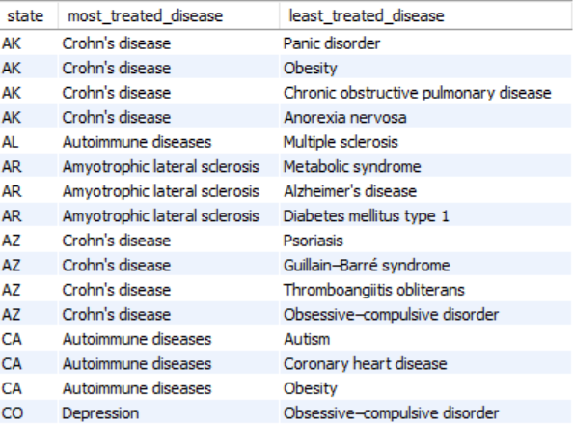
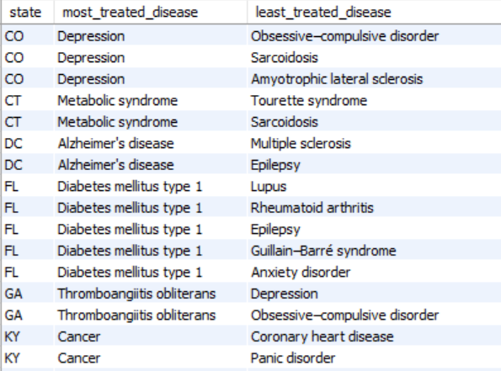
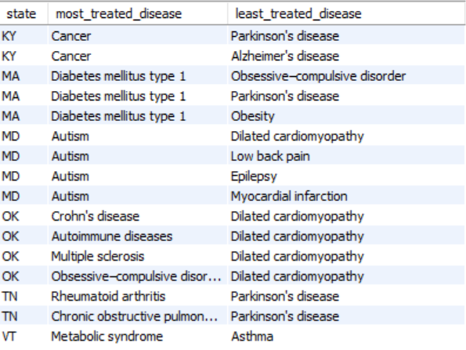

Slide 9
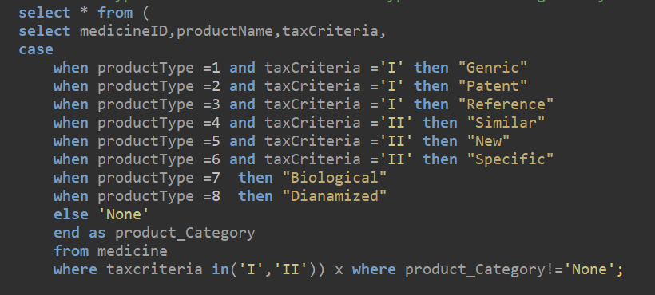
“HealthDirect” pharmacy finds it difficult to deal with the product type of medicine being displayed in numerical form, they want the product type in words. Also, they want to filter the medicines based on tax criteria. Display only the medicines of product categories 1, 2, and 3 for medicines that come under tax category I and medicines of product categories 4, 5, and 6 for medicines that come under tax category II. Write a SQL query to solve this problem. ProductType numerical form and ProductType in words are given by 1 - Generic, 2 - Patent, 3 - Reference, 4 - Similar, 5 - New, 6 - Specific,7 - Biological, 8 – Dinamized

Slide 10
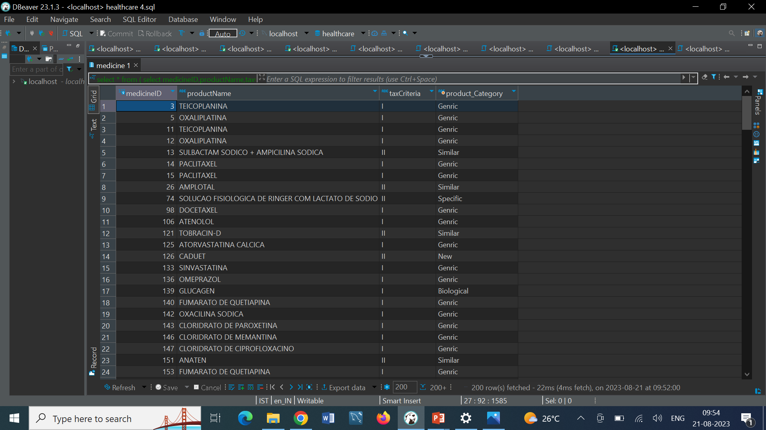

Slide 11
Insurance companies want to evaluate the performance of different insurance plans they offer. Generate a report that shows each insurance plan, the company that issues the plan, and the number of treatments the plan was claimed for. The report would be more relevant if the data compares the performance for different years(2020, 2021 and 2022) and if the report also includes the total number of claims in the different years, as well as the total number of claims for each plan, each company in all 3 years combined.

Slide 12
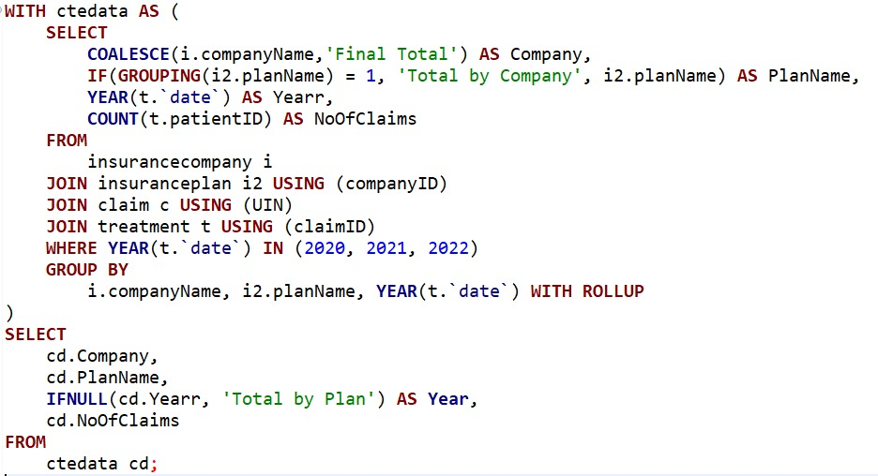
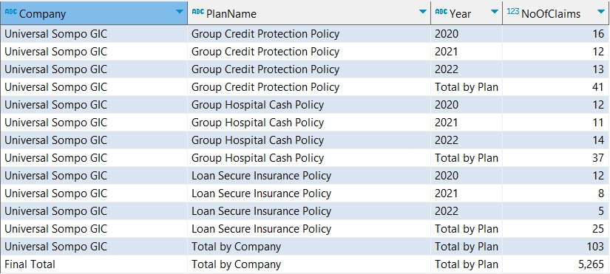

Slide 13
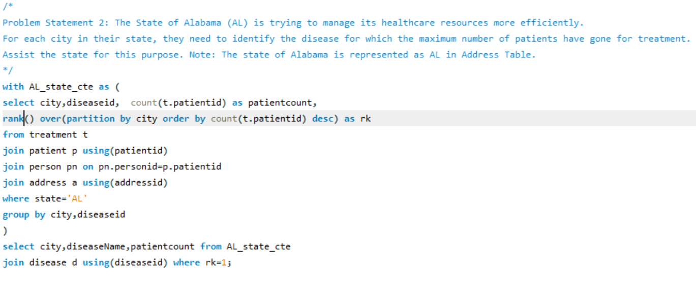
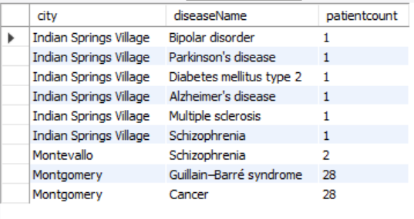
The State of Alabama (AL) is trying to manage its healthcare resources more efficiently.For each city in their state, they need to identify the disease for which the maximum number of patients have gone for treatment. Assist the state for this purpose. Note: The state of Alabama is represented as AL in Address Table.

Slide 14
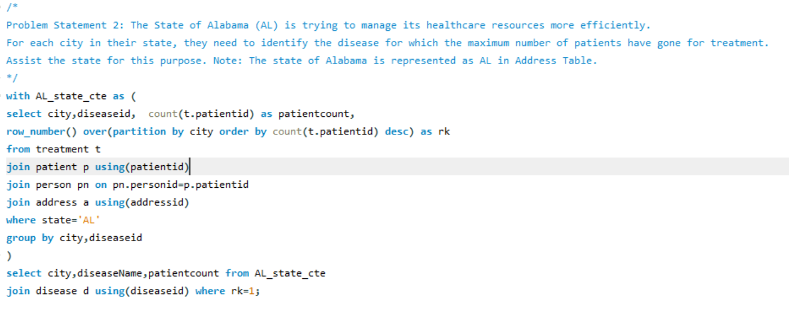
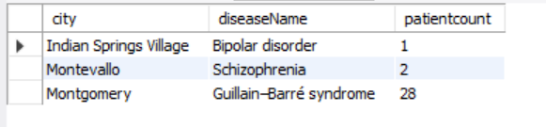

Slide 15
Jacob, as a business strategist, wants to figure out if a state is appropriate for setting up an insurance company or not.Write a stored procedure that finds the num_patients, num_insurance_companies, and insurance_patient_ratio, the stored procedure should also find the avg_insurance_patient_ratio and if the insurance_patient_ratio of the given state is less than the avg_insurance_patient_ratio then it Recommendation section can have the value “Recommended” otherwise the value can be “Not Recommended”.

Slide 16
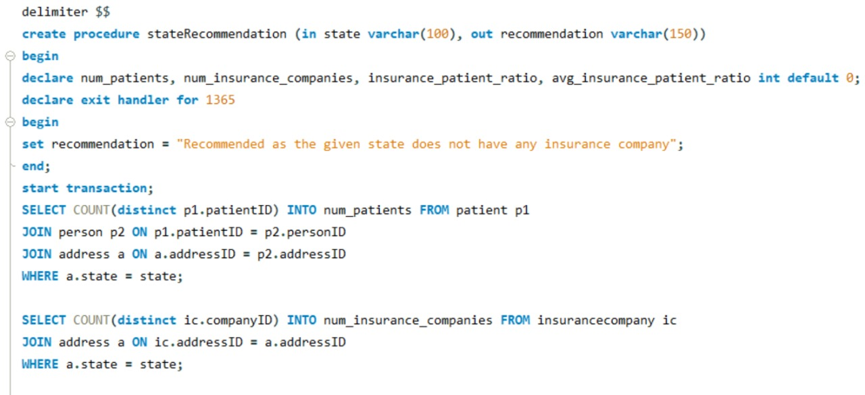
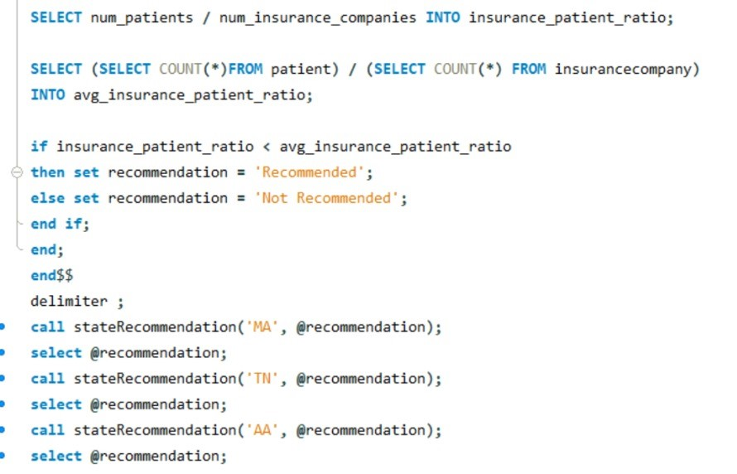

Slide 17
The healthcare department has requested an application that finds out the disease that was spread the most in a state for a given year. So that they can use the information to compare the historical data and gain some insight.Create a stored function that returns the name of the disease for which the patients from a particular state had the most number of treatments for a particular year. Provided the name of the state and year is passed to the stored function.

Slide 18
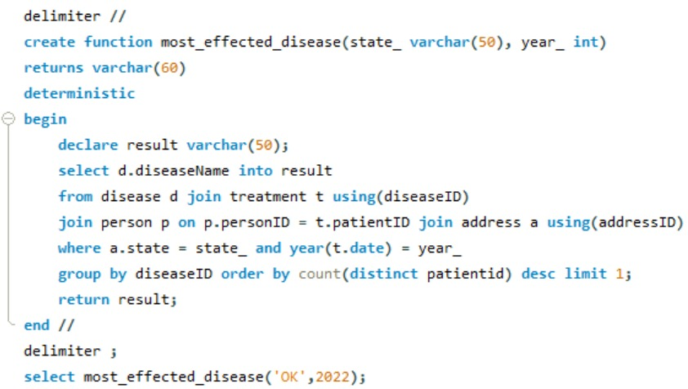
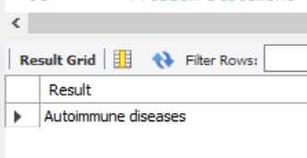

Slide 19
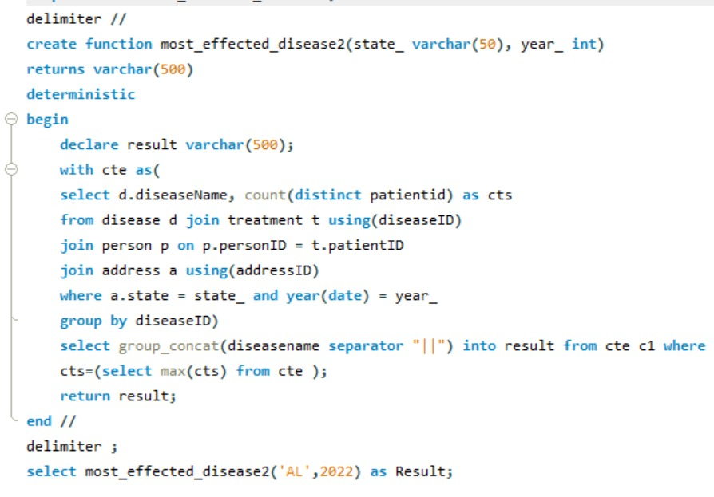
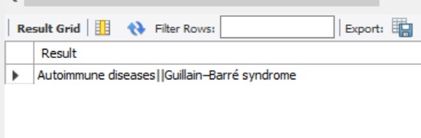

Slide 20
Headline Statistics (1/2):
Average Execution Time : 62.5 ms
Wakatime Metrics :
Total Coding Time: 15 mins​
Daily Coding Activity: 5 hrs​
Most Active Time: 9 am to 4pm
Top files and languages : Healthcare.sql(SQL)​
Lines of Codes (LoC/KLoC) : 16 lines​ ​
Total number of functions : 2
Number of user-defined functions used : 0​ ​
Avg. number of lines per function : 5-6 lines​

Slide 21
Headline Statistics (2/2):
Number of comments written : 2 comments
IDE/Code Editor Used : SQL Workbench
Plugins Used : None​
Function/Complexity breakdown:
Simple Implementations - Grouping data and Rollup, Agregate function, Joins
Intermediate Implementations - With case, CTE, sub query,
Complex Implementations – Stored Routines

Slide 22
Thank You

